Slide 1
Presented December 13, 2018

Slide 2

EMS RFP Presentation
Doug Wolfberg
Steve Wirth
Ken Brody
Page, Wolfberg & Wirth, LLC
Solano EMS Cooperative
2020-2030 EMS RFP Process

Slide 3


Brian Dale
Fire Chief (Ret.),
Salt Lake City Fire Department
30 year fire service career
Former Division Chief, Medical Services Bureau
SLCFD
Currently Associate Director of Medical and Quality Control Processes
IAED
International Academies of Emergency Dispatch

Slide 4
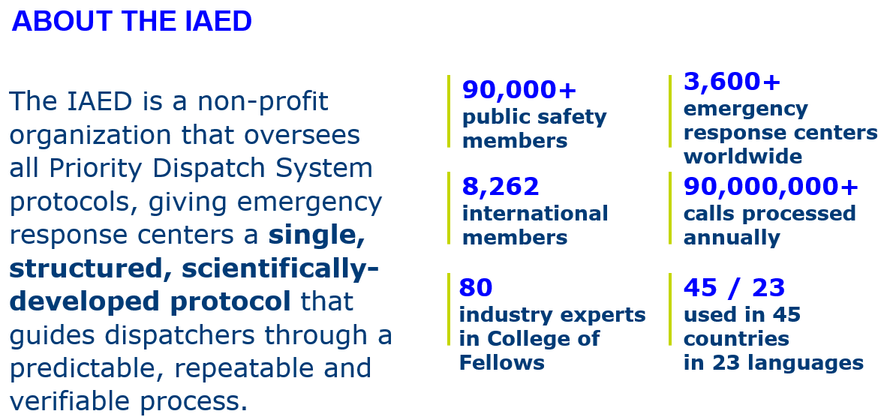

Slide 5
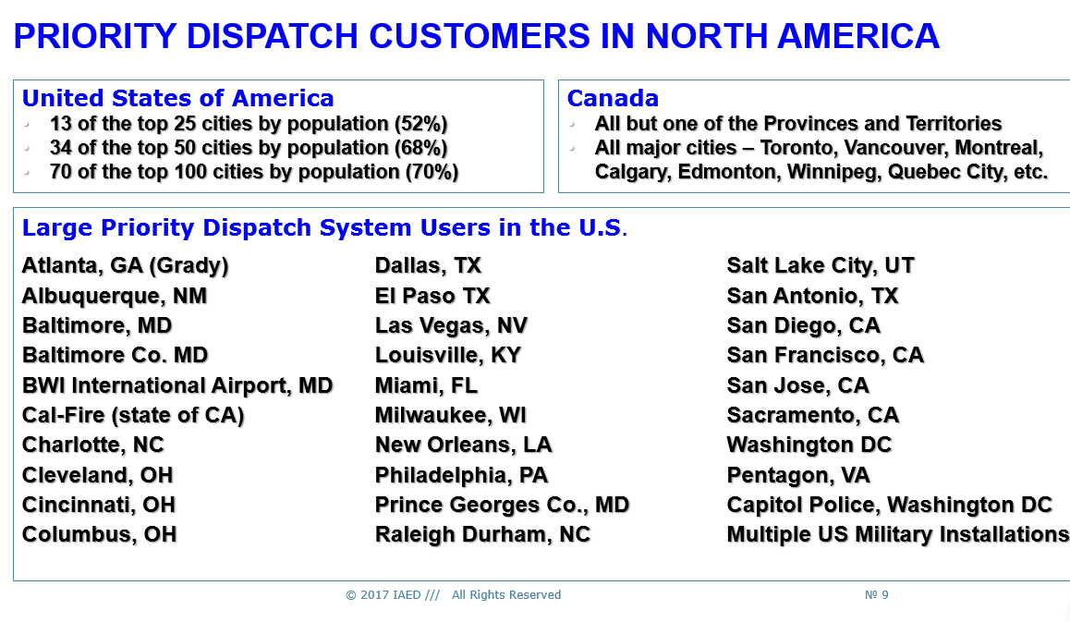

Slide 6
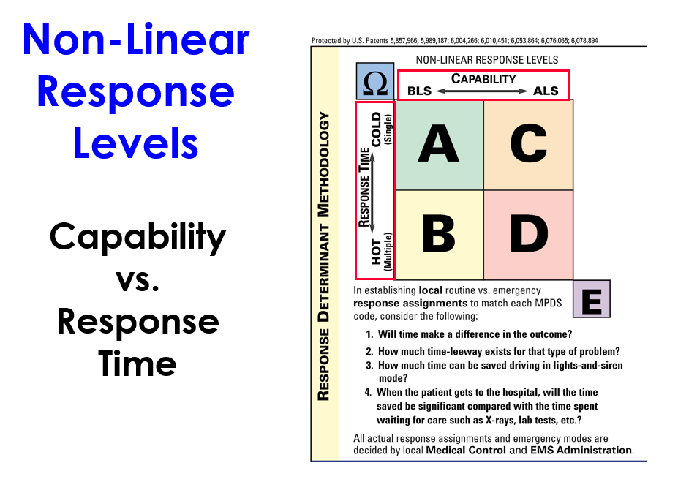

Slide 7
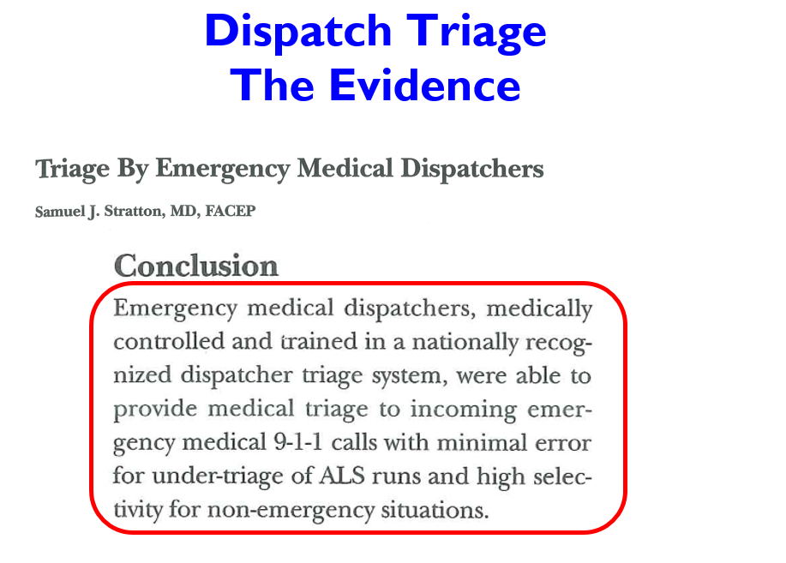

Slide 8
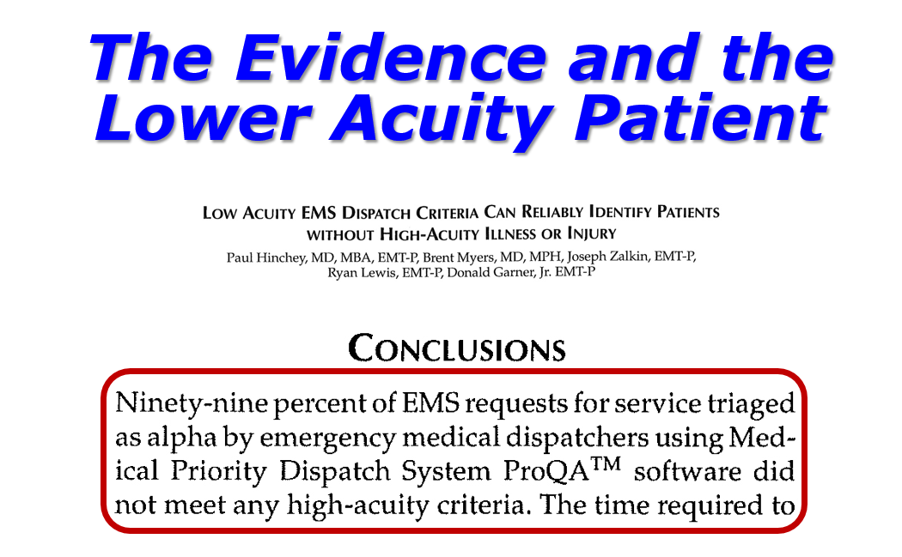

Slide 9
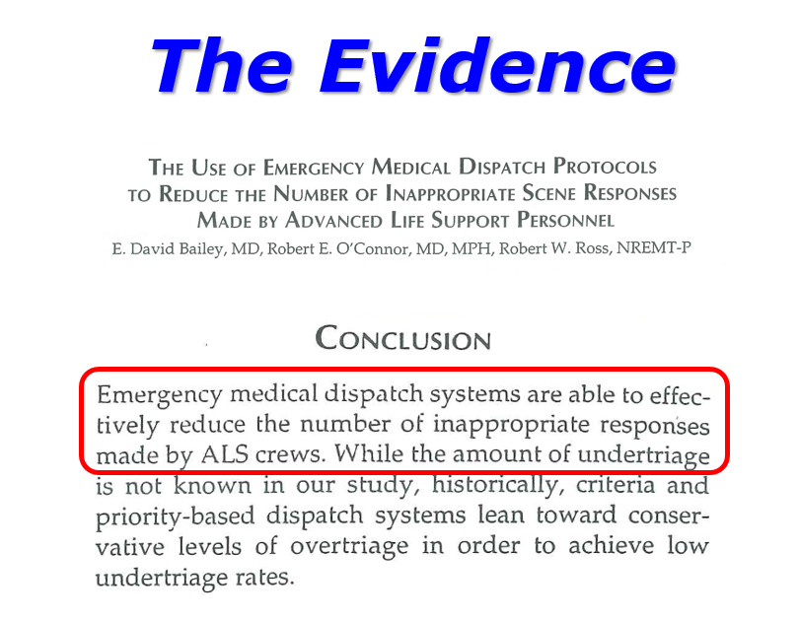

Slide 10
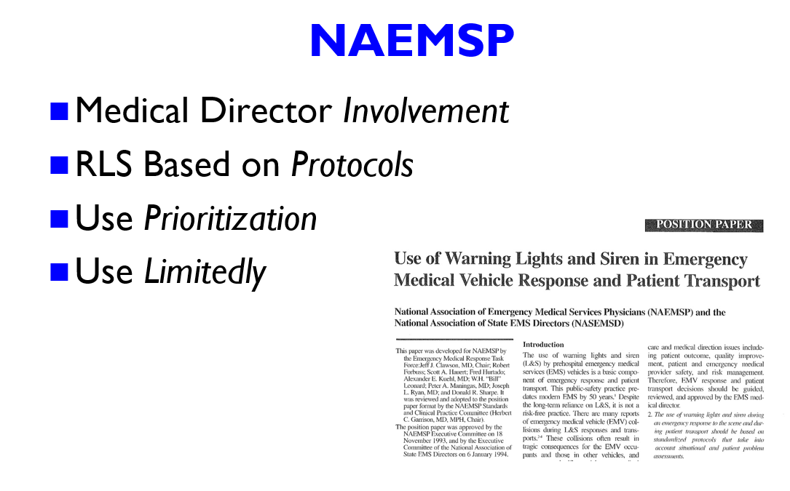

Slide 11
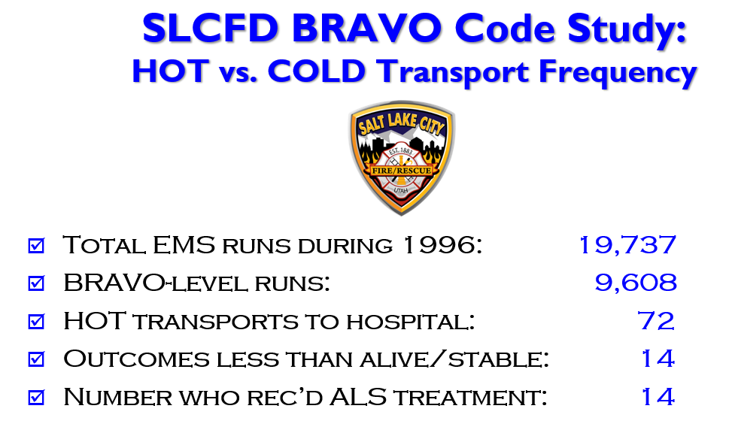

Slide 12
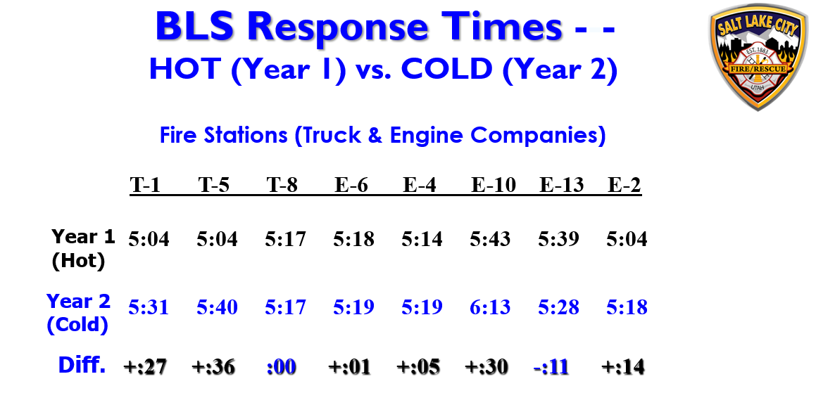

Slide 13
EMS RFP Presentation
Doug Wolfberg
Steve Wirth
Ken Brody
Page, Wolfberg & Wirth, LLC
Solano EMS Cooperative
2020-2030 EMS RFP Process

Slide 14
About PWW
PWW is a national EMS law and consulting firm based on Pennsylvania
Our firm’s principals have decades of hands-on EMS, fire, rescue and emergency services experience

Slide 15



James O. Page
Our Founding Partner, James O. Page, was a longtime Fire Chief in several departments in California and also worked for many years at LA County F.D.
He also founded Jems and was the Technical Advisor to the TV show Emergency!

Slide 16


Douglas M. Wolfberg
Started in EMS and rescue in 1978 as a provider
Served as a county and regional EMS director
Worked for a state EMS agency and in US DHHS Division of EMS Systems prior to law school

Slide 17
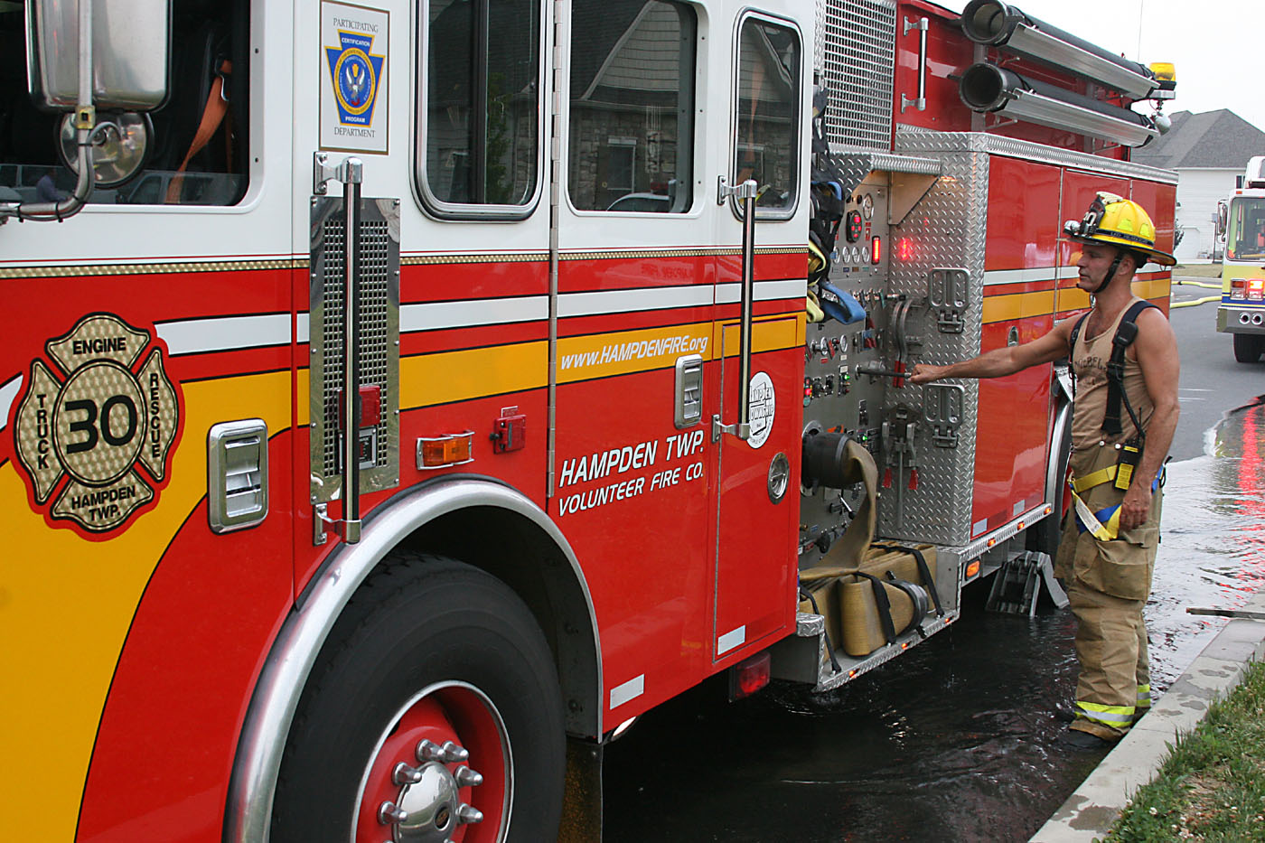
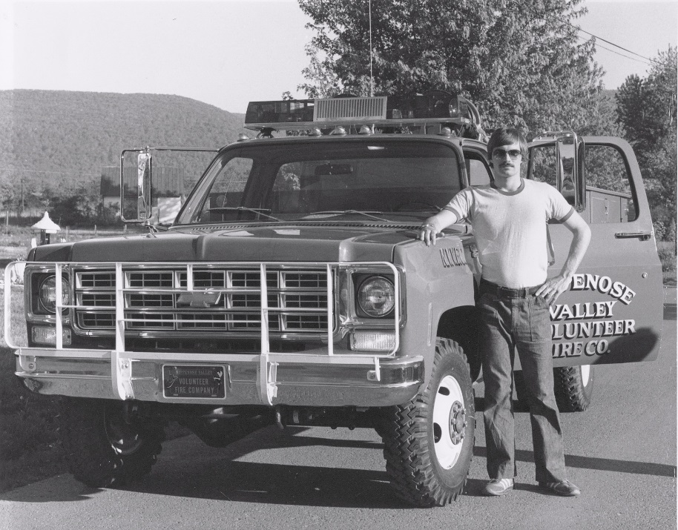
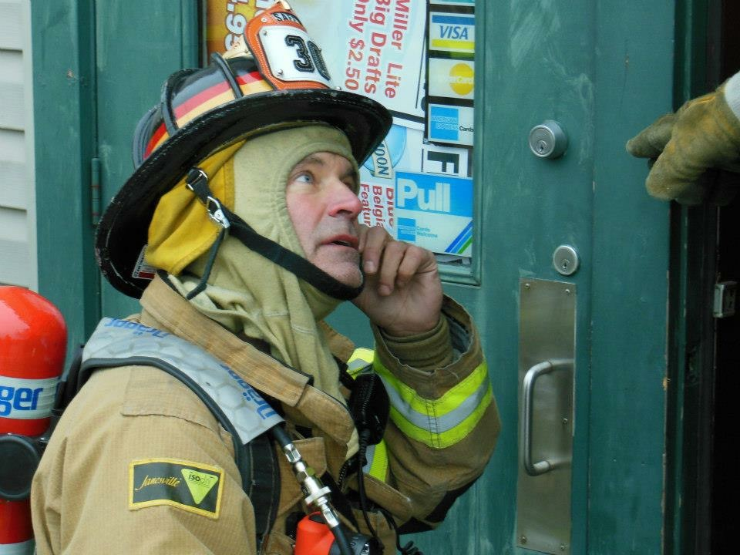
Stephen R. Wirth
Has served in multiple capacities including as a firefighter, assistant fire chief, paramedic and EMS executive since the 1970s
One of central PA’s first paramedics

Slide 18

Kenneth E. Brody
For over 20 years, Ken served as counsel to a state EMS agency
Ken has been extensively involved in EMS legal and consulting work in California and nationally

Slide 19

PWW’s California Connection
PWW also had a California office for the first several years of its existence until the passing of Jim Page in 2004

Slide 20
PWW’s California Connection
PWW’s work in California has spanned 20 years
In California specifically, we have represented:
  Cities
  Fire Districts
  Local EMS Agencies
  Ground and Air Ambulance Companies
  Hospitals
  Firefighters Unions

Slide 21
PWW’s California Connection
PWW professionals have been invited to lecture for many statewide organizations in California over the past 20 years, including:
  Cal Chiefs
  EMSAAC
  CAA

Slide 22
PWW’s California Connection
PWW has appeared in California courts – including at the local and appellate levels – in cases arising under the California EMS Act, including Sections 201 and 224
PWW has conducted numerous competitive procurement processes and EMS system assessments in Counties throughout California, including Orange, Yolo, Merced and others

Slide 23
Project Timeline
Phase I – EMS System Review July – Sept 2018
  Data and documentation review 6 meetings total
  Stakeholder engagement process
Phase II – Draft RFP Oct ‘18 – Feb ‘19
  SEMSC and stakeholder review
  Submission to EMSA
Phase III – Proposal Review, Mar – Sept 2019
Scoring and Contractor Selection

Slide 24
Project Timeline
Phase I – EMS System Review July – Sept 2018
  Data and documentation review 6 meetings total
  Stakeholder engagement process
Phase II – Draft RFP Oct ‘18 – Feb ‘19
  SEMSC and stakeholder review
  Submission to EMSA
Phase III – Proposal Review, Mar – Sept 2019
Scoring and Contractor Selection
MAYBEMAYBE

Slide 25
Project Timeline
The timeline will ultimately depend upon:
  Timing of Board-requested revisions
  Timing of Board approval
  Timing of EMSA review

Slide 26
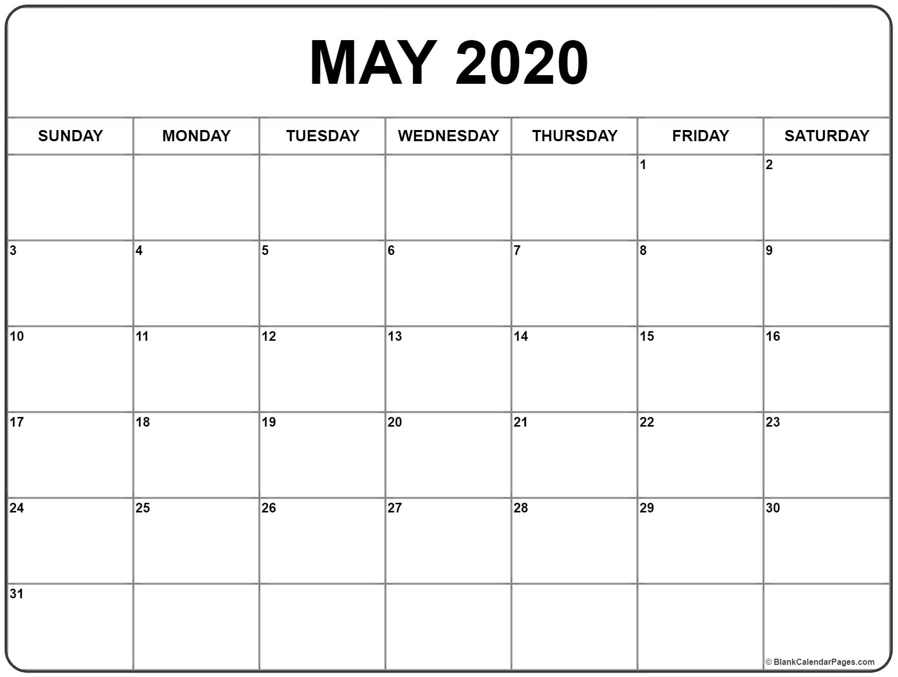
Current Contract Expiration

Slide 27

The Draft RFP
This document is a DRAFT

Slide 28
What the Draft RFP Is and Isn’t
Is a set of recommendations by the SEMSC consultants
Is patient-centered and reflects published, peer-reviewed data, evidence, and national best practices
Is not the official policy of SEMSC or Solano County
Is not intended to reflect political considerations – that is up to the SEMSC Board

Slide 29
We have presented a proposed EMS system model that is:
- Patient-centered
- Evidence-based
- Clinically justified
- Cost-effective
- Economically sustainable

Slide 30
We have presented a proposed EMS system model that is:
- Patient-centered
- Evidence-based
- Clinically justified
- Cost-effective
- Economically sustainable

Slide 31
We have presented a proposed EMS system model that is:
- Patient-centered
- Evidence-based
- Clinically justified
- Cost-effective
- Economically sustainable

Slide 32
We have presented a proposed EMS system model that is:
- Patient-centered
- Evidence-based
- Clinically justified
- Cost-effective
- Economically sustainable

Slide 33
We have presented a proposed EMS system model that is:
- Patient-centered
- Evidence-based
- Clinically justified
- Cost-effective
- Economically sustainable

Slide 34
We have presented a proposed EMS system model that is:
- Patient-centered
- Evidence-based
- Clinically justified
- Cost-effective
- Economically sustainable

Slide 35
We have presented a proposed EMS system model that is:
- Patient-centered
- Evidence-based
- Clinically justified
- Cost-effective
- Economically sustainable

Slide 36
RFP Overview
Introduction
Procurement Info
The Solano County EMS System
Minimum Proposer Requirements
Competitive Proposal Criteria
Contractual Provisions

Slide 37
I. Introduction
RFP Overview
Scope of Services
  Emergency Ambulance Services
  ALS Interfacility Ambulance Services
  CCT Services

Slide 38
I. Introduction
Geographic Scope of EOA
  All of Solano County except
    City of Vacaville
    The area described in the Solano EMS Plan as “Zone C”
      - Note: this is a proposed change from the EMS Blueprint
      Report, which recommended including “Zone C” in the EOA
      - But, note that “201 rights” under California law do not include areas outside the geographic boundaries of a city
      - Vacaville Fire’s exclusivity in “Zone C” arises under Section 224 of the EMS Act, not under Section 201
      - The Zone C boundaries are undergoing further review
    Travis AFB

Slide 39
I. Introduction
Geographic Scope of EOA (continued)
  EOA also includes portions of Sacramento County (River and Delta FPD areas and City of Isleton) as is currently the case

Slide 40
I. Introduction
Agreement Term – 5 years + one renewal period of up to 5 additional years
Policy Goals
Fees
  Contract Award Fee: $100,000
  Annual Franchise Fee: $600,000
Disclaimer and Release

Slide 41
II. Procurement Information
Performance-Based Contract
Notice to Proposers – SEMSC reserves right to cancel the RFP, etc.
Non-Collusion (exception for bona fide joint ventures)

Slide 42
II. Procurement Information
Procurement Time Line – dates TBD based on SEMSC and EMSA approval
Procurement Process
  Mandatory pre-bid conference
  Electronic submission of proposals via Public Purchase

Slide 43
II. Procurement Information
Procurement Process (continued)
  Independent Review Panel
    7 disinterested individuals from inside or outside of Solano County
    IRP meetings will be closed to public
    Improper contact and/or communications with IRP members is prohibited

Slide 44
II. Procurement Information
Procurement Process (continued)
  Proposal Review Process
    Responsiveness Review – staff review to determine if all minimum requirements are met and if proposal is responsive to RFP specifications
    Review Panel Review
      Price Scoring – based on “Composite Total Charge”

Slide 45
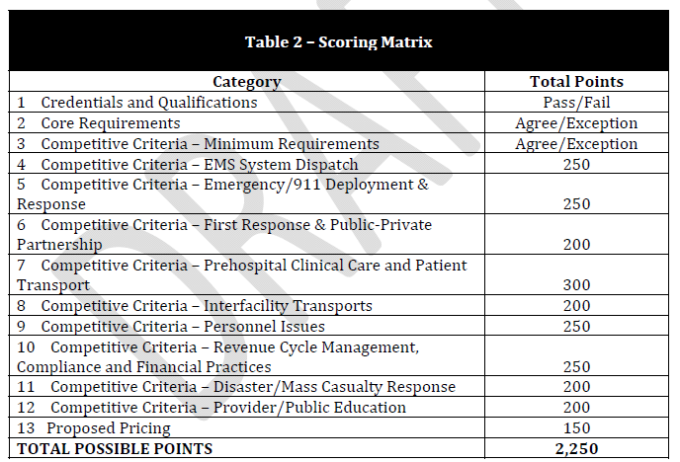

Slide 46
II. Procurement Information
Procurement Process (continued)
  Proposal Review Process
    Post-Submission Presentation – top 3 proposals
    Investigation/background checks
    Notification of award
    Protest and appeal procedures
      First level – informal meeting
      Second level – independent review
      Third level – Solano County Public Health Officer

Slide 47
III. Solano County EMS System
This section contains an overview of the existing EMS system
  Notably, there are 7 PSAPs in Solano County
  Only two of them, plus the incumbent Contractor, furnish EMD

Slide 48
III. Solano County EMS System
Payer Mix Data
  SEMSC did not have payer mix data available from incumbent Contractor to include in Blueprint Report
  Blueprint Report contained payer mix data from area Emergency Departments as an approximation of EMS payer mix
  Contractor provided unaudited payer mix data for unspecified time period in its public comments
  Both have been incorporated into Draft RFP

Slide 49
IV. Minimum Proposer Requirements
Organizational Disclosures – legal name, corporate info, ownership, affiliated entities, tax status, etc.
Experience
  Must have current + 5 years prior experience providing ALS-level emergency ambulance service in an EOA with a minimum population of 300,000
  This is the approximate population of the Solano EOA; not an “arbitrary” figure

Slide 50
IV. Minimum Proposer Requirements
Experience (continued)
  Many other California RFPs include population-based, ALS EOA experience requirements
  Alameda, Napa, San Joaquin, Yolo, Fresno, Merced, San Mateo, etc.

Slide 51
IV. Minimum Proposer Requirements
Experience (continued)
  Draft RFP also contains a CCT experience requirement

Slide 52
IV. Minimum Proposer Requirements
Experience (continued)
  Some public comments addressed the experience requirement, with some commenters supporting elimination of the experience requirement
  In our opinion, for a contract of this importance, providers should have to have actual experience in providing the types of services covered by the contract - i.e., emergency ambulance and CCT services

Slide 53
IV. Minimum Proposer Requirements
Key Contractor Personnel
  Draft RFP also contains minimum experience requirements for key personnel, including CEO, COO, CFO, CCO, CPO, Medical Director, QI Coordinator
  Also contains incumbent workforce protections (this is a fairly standard EMS RFP provision)

Slide 54
IV. Minimum Proposer Requirements
Key Contractor Personnel (continued)
  The Draft RFP contains numerous external certification requirements for key personnel where there are applicable national standards and credentials
  Examples:
    American College of Paramedic Executives (Executive Paramedic Officer, Managing Paramedic Officer)
    National Academy of Ambulance Compliance (Certified Ambulance Compliance Officer, Certified Ambulance Coder, Certified Ambulance Privacy Officer)

Slide 55
Disclosure
The National Academy of Ambulance Compliance (NAAC) is under common ownership with Page, Wolfberg & Wirth, LLC

Slide 56
IV. Minimum Proposer Requirements
Legal Actions – proposers must disclose pending or resolved lawsuits, investigations, etc.
Financial Stability
  Proposers must demonstrate financial stability, cash reserves, creditworthiness and bankruptcy history
  Must also furnish a minimum of $5 million in performance security

Slide 57
IV. Minimum Proposer Requirements
Insurance Requirements
  Draft RFP requires multiple types of insurance policies at required minimum coverage limits

Slide 58
V. Competitive Proposal Criteria
EMS System Dispatch and Communications
  Draft RFP requires a centralized, secondary PSAP with full Emergency Medical Dispatch (EMD) and Pre-Arrival Instructions (PAI)
  Full EMD would take effect at time of contract; PAI would be required within one year of contract start date

Slide 59
V. Competitive Proposal Criteria
EMS System Dispatch and Communications (cont’d)
  Draft RFP proposes two options for centralized secondary PSAP
    Contractor-operated secondary PSAP
    Contractor staffs EMD positions in Solano County Sheriff’s Office PSAP

Slide 60
V. Competitive Proposal Criteria
EMS System Dispatch and Communications (cont’d)
  Note: Draft RFP contains a change from the Blueprint Report regarding calls in the City of Vacaville
  All 911 calls originating in the City’s service area would not require transfer to the centralized secondary PSAP

Slide 61
V. Competitive Proposal Criteria
EMS System Dispatch and Communications (cont’d)
  Dispatch based on standard response determinants established by the National Academies of Emergency Dispatch (NAED)
  These utilize Alpha, Bravo, Charlie, Delta and Echo response levels based on patient acuity
  Final response determinants and dispatch levels would be up to SEMSC Medical Director with input from Physicians Forum

Slide 62
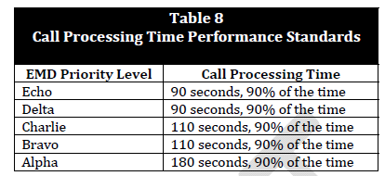
V. Competitive Proposal Criteria
EMS System Dispatch and Communications (cont’d)
  Draft RFP also proposes “Call Processing Time” measurement and performance standards
  Red lights and sirens (RLS) responses would be limited to high-acuity calls (Delta/Echo) and a 50% RLS benchmark

Slide 63
V. Competitive Proposal Criteria
EMS System Dispatch and Communications (cont’d)
  Extensive public comments received on this issue
  Most comments support EMD but opposed the idea of a private contractor operating a secondary PSAP
  Commenters who opposed a private contractor operating a secondary PSAP generally expressed distrust and conflict of interest concerns over a contractor performing this function

Slide 64
V. Competitive Proposal Criteria
EMS System Dispatch and Communications (cont’d)
  Draft RFP contains numerous safeguards over dispatch
    Extensive dispatch data reporting and SEMSC oversight
    All dispatch protocols subject to SEMSC Medical Director approval
    Contractor required to implement a dispatch QI program
    Any manipulation of dispatch info or response priorities constitutes a breach and is grounds for termination of the contract

Slide 65
V. Competitive Proposal Criteria
EMS System Dispatch and Communications (cont’d)
  The reality is that Solano County has a fragmented EMS dispatch system and 911 callers do not receive EMD or PAI in most areas of the County
  Most of the municipal PSAPs in Solano County have elected not to implement EMD or PAI
  Including this in the RFP and contract is the quickest and most cost-effective way to obtain full county-wide EMD coverage with medical pre-arrival instructions

Slide 66
V. Competitive Proposal Criteria
EMS System Dispatch and Communications (cont’d)
  This is a national standard of care in which Solano County lags behind other EMS systems
  The lack of EMD/PAI in most of the County puts the public at direct risk
    No real-time medical instructions for callers
    Excessive and unwarranted red lights and siren responses

Slide 67
V. Competitive Proposal Criteria
EMS System Dispatch and Communications (cont’d)
  Some of the Blueprint Report public comments also objected to the contractor dispatching fire department first response agencies
  The Draft RFP modified the recommendations in the Blueprint report and requires the contractor to relay all information to the appropriate local PSAP for dispatch of fire first response resources

Slide 68
V. Competitive Proposal Criteria
EMS System Dispatch and Communications (cont’d)
  Optional Criteria:
    NAED Accredited Center of Excellence designation for contractor’s dispatch center
    Automated AED geo-location
    Emergency Communications Nurse System (ECNS) and NAED “Omega” protocol
      This would create an alternative disposition option for 911 calls that do not require an EMS response (social services referrals, mental health, addiction referrals, etc.)

Slide 69
V. Competitive Proposal Criteria
Emergency/911 Ambulance Deployment/Response
  All high-acuity (or potentially high-acuity calls) - Delta/Echo – receive an ALS ambulance and fire department first response
  Response time standards are the same as they are currently for these calls
  There are no changes whatsoever to the dispatch, response times, or deployment for these emergency calls in any areas of Solano County
  Full ALS ambulance response + fire department first response for Charlie-level calls

Slide 70
V. Competitive Proposal Criteria
Emergency/911 Ambulance Deployment/Response
  Alpha/Bravo calls are low-acuity calls that are non-emergent under the dispatch protocols
    The contractor may respond to these calls with either ALS or BLS ambulances
    Fire departments to receive notification of 100% of these calls and may respond at their option to any and every call they wish; that is completely up to the discretion of the cities/fire departments

Slide 72
V. Competitive Proposal Criteria
Emergency/911 Ambulance Deployment/Response
  This section also contains vehicle maintenance and minimum fleet size requirements

Slide 73
V. Competitive Proposal Criteria
First Response and Public-Private Partnership
  Final PPP agreement to be developed by SEMSC after contractor selection and consultation with all parties
  Proposers required to submit their unit hour cost calculations for Charlie/Delta/Echo responses and base their proposed PPP compensation on unit hour savings as is currently done
  Contractor also required to restock supplies and medications, and to cooperate with PPP cities on training

Slide 74
V. Competitive Proposal Criteria
First Response and Public-Private Partnership
  Contractor would not compensate the PPP cities for:
    Charlie/Delta/Echo responses in which contractor places an ambulance on scene prior to first response arrival
    Any “optional response” Alpha/Bravo-level calls; providing these services is completely at the city/fire department discretion
  Contractor would pay per-call fee for other PPP services that have a direct benefit to the contractor
    E.g., use of the PPP medic during ambulance transport

Slide 75
V. Competitive Proposal Criteria
First Response and Public-Private Partnership
  Numerous public comments submitted regarding funding of fire departments through the PPP
  Whether or not these provisions of the Draft RFP would result in reduced payments to the PPP entirely depends upon the unit hour calculations submitted by the proposers

Slide 76
V. Competitive Proposal Criteria
First Response and Public-Private Partnership
  However, there are three critically important issues in regard to the PPP payment proposals:
    First, they must be cost-based in accordance with documented unit-hour cost savings to the contractor
      Proposing amounts in excess of documented costs that directly relate to cost savings realized by the contractor quite likely would implicate the Federal Anti-Kickback Statute, which is a felony under Federal law

Slide 77
V. Competitive Proposal Criteria
First Response and Public-Private Partnership
  However, there are three critically important issues in regard to the PPP payment proposals:
    Second, as a matter of public policy, ambulance contractors should not be required to pay a city to furnish first response services for low-acuity calls that do not require first response services

Slide 78
V. Competitive Proposal Criteria
First Response and Public-Private Partnership
  However, there are three critically important issues in regard to the PPP payment proposals:
    Third, ambulance reimbursement fee schedules from Medicare, MediCal, and other government payers fall short of reimbursing ambulance providers even for the cost of their transport services
      Ambulance fee schedule payments are related to ambulance transport costs – these reimbursement amounts are not designed to pay costs of municipal fire department first response

Slide 79
V. Competitive Proposal Criteria
First Response and Public-Private Partnership
  Other systems in California have placed substantial first response payment requirements on their contractors, only to push those systems to financial collapse
  If the system fails, County taxpayers will ultimately have to foot the bill for a contractor bailout as occurred in Alameda County (emergency $4 million contractor subsidy in 2015) and Santa Clara County (emergency $7 million contractor subsidy in 2016)
    Ultimately this had the effect of simply transferring tax burdens from city to county taxpayers

Slide 80
V. Competitive Proposal Criteria
First Response and Public-Private Partnership
  SEMSC must move forward with a financially sustainable EMS system design for the next 10-year horizon
  Health care reimbursement is shifting to pay for performance and outcome-based reimbursement
  This means that health care systems – EMS included – should not be saddled with costs for practices that do not benefit patients

Slide 81
V. Competitive Proposal Criteria
First Response and Public-Private Partnership
  The evidence is crystal clear that ALS first response does not improve patient outcomes on low-acuity calls – like sprained ankles, minor cuts and abrasions, low back pain and other calls – that can be handled safely and effectively by a basic life support ambulance only

Slide 82
V. Competitive Proposal Criteria
First Response and Public-Private Partnership
  The job of SEMSC is to ensure a patient-centered, evidence-based, clinically outstanding and financially sustainable EMS system

Slide 83
V. Competitive Proposal Criteria
Prehospital Clinical Care and Patient Transport
  This section addresses protocol implementation and clinical benchmarking that must be performed by the contractor
  Contains requirements for prompt STEMI, trauma, stroke and MCI alerts
  Requires contractor to provide extra training to EMS staff on infrequently-utilized skills
  Contractor must establish a portal for real-time access and monitoring by SEMSC of contractor’s patient care reporting system

Slide 84
V. Competitive Proposal Criteria
Prehospital Clinical Care and Patient Transport
  Establishes a benchmark of <5% for RLS use during patient transport in accordance with published national standards
  Requires contractor to integrate its records with local Health Information Exchanges (HIEs) to facilitate enhanced access to medical records by patients

Slide 85
V. Competitive Proposal Criteria
Prehospital Clinical Care and Patient Transport
  Contains an optional specification for the contractor to obtain documentation certification credentials of their clinical staff (CADS credential through NAAC)
  Optional specification for working with cities on 5150 transports

Slide 86
V. Competitive Proposal Criteria
Interfacility Transports
  EOA would include all ALS interfacility transports (as is presently the case)
  Contractor required to maintain the existing ALS+RN program
    This furnishes RN-level care for transports that exceed paramedic scope of practice but that do not rise to the level of CCT under Federal regulations

Slide 87
V. Competitive Proposal Criteria
Interfacility Transports
  Draft RFP also includes CCTs in the EOA
    We believe this is necessary due to substantially reduced CCT volume
    Insufficient market incentives to maintain competitive CCT resources capable of responding in the times necessary
    This proposal is opposed by the current contractor
      This is a high-cost, low-volume service, but we believe the contractor’s emergency and ALS interfacility exclusivity will offset its increased costs of having to provide CCT services under the contract

Slide 88
V. Competitive Proposal Criteria
Interfacility Transports
  Draft RFP recommends implementation of a Re-Triage Transport (RTT) program
    Utilized on occasions when the facility believes an incoming ED patient will require transfer to another facility within 15 minutes
    If contractor cannot place an ambulance at the facility in that 15-minute time period, the facility may utilize the ambulance that initially transported the patient to the ED (provided it is willing and County-permitted to perform the RTT)
    This provision is opposed by the current contractor
      Will require ongoing monitoring of RTT utilization and adjustment if necessary

Slide 89
V. Competitive Proposal Criteria
Personnel Issues
  Contractor must perform background checks, etc.
  Implement drug testing procedures
  Anti-fatigue policy – minimum of 8 hours between shifts
  16-hour max shift lengths without SEMSC approval
  Proposers must submit plan for achieving a culturally diverse workplace

Slide 90
V. Competitive Proposal Criteria
Personnel Issues
  Numerous specific training requirements for both ALS and BLS staff
  Stress management/suicide prevention resources for staff
  Plan for adequate comfort facilities for employees while posted

Slide 91
V. Competitive Proposal Criteria
Revenue Cycle Management, Compliance and Financial Practices
  Proposers must utilize financial hardship criteria for patients who cannot afford to pay their bills
  Protection for Qualified Medicare Beneficiaries (QMBs) from billing or collection actions
  Billers/coders must be certified
  Contractor must have a compliance program in place for billing and for patient privacy

Slide 92
V. Competitive Proposal Criteria
Revenue Cycle Management, Compliance and Financial Practices
  Contractor entitled to annual automatic rate increases equivalent to the CPI
  No automatic increase if CPI is zero or negative
    This provision is opposed by current contractor
    We note that contractor may still request an increase in these situations or if there are changed circumstances

Slide 93
V. Competitive Proposal Criteria
Revenue Cycle Management, Compliance and Financial Practices
  Contractor must submit annual independent financial audit
  Contractor must undergo an annual billing and coding audit
  Specific financial and revenue data must be reported
    This is intended to facilitate local EMS agency oversight, spot warning trends of financial distress in the EMS system, and facilitate planning for future contracting cycles

Slide 94
V. Competitive Proposal Criteria
Disaster/Mass Casualty Incident Response
  Proposals must include description of disaster/MCI capacity
  Must coordinate with SEMSC and other public safety agencies
  Ambulance Strike Team obligations

Slide 95
V. Competitive Proposal Criteria
Provider/Public Education
  Proposals must include plan for provider education, continuing ed and maintaining certifications
  Must also address core public education issues, including appropriate EMS system utilization, CPR/AED, etc.

Slide 96
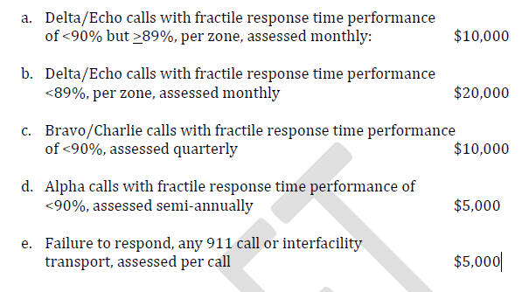
VI. Contractual Provisions
Liquidated Damages
  Compliance with performance standards - these are financial assessments against the contractor if it fails to meet applicable standards in the RFP and contract
  911 response deficiencies

Slide 97
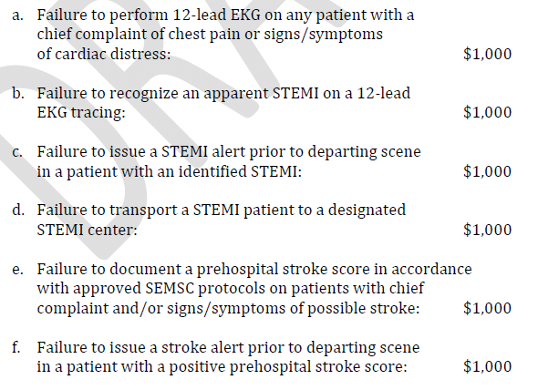
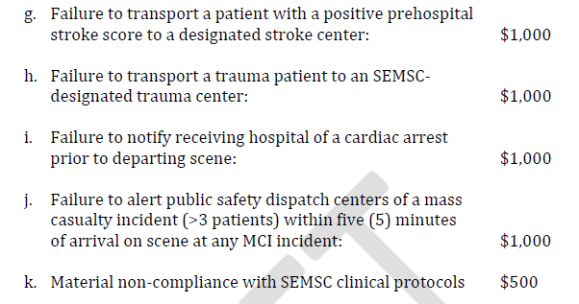
VI. Contractual Provisions
Liquidated Damages
  Failure to maintain CAAS accreditation ($10,000)
  Clinical performance deficiencies

Slide 98
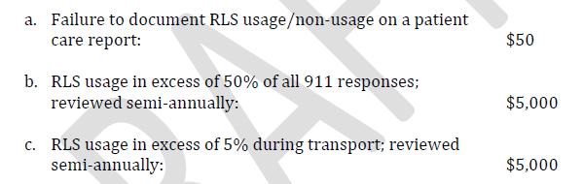

VI. Contractual Provisions
Liquidated Damages
  Red Lights and Siren (RLS) Usage
  Employee Turnover
  Other deficiencies as determined by SEMSC

Slide 99
VI. Contractual Provisions
Breach of Contract
  The RFP specifies that any violation of material terms and conditions by the contractor constitutes a breach
  Also lists 17 specific breach conditions

Slide 100
VI. Contractual Provisions
Emergency Takeover
  The RFP affords SEMSC the right to take over contractor’s operations in the event of a material breach that affects or could affect public health or safety
  The RFP sets forth detailed procedures for the use of the required performance security, contractor’s vehicles and assets, etc.

Slide 101
VI. Contractual Provisions
Order of Precedence
  This provision states that the following documents control – in this order – in the event of a conflict between the documents:
    Contract
    RFP
    Contractor’s Proposal

Slide 102
VI. Contractual Provisions
Financially Distressed EMS System
  This provision affords SEMSC the option to waive the franchise fee or liquidated damages provisions, or make system changes, in the event SEMSC determines the contractor to be at imminent risk of financial insolvency

Slide 103
VI. Contractual Provisions
Other Provisions
  Contract modifications – if necessary
  Subcontracting – not permitted except for CCT/RTT
  Contract Evaluation and Assessment – 60 day initial period
  Lame Duck Provisions – contractor may not scale down if new contract awarded to another entity at end of the procurement cycle

Slide 104
VI. Contractual Provisions
Other Provisions
  Right to Enter and Inspect
  Independent Contractor Relationship
  Indemnification and Consent to Jurisdiction
  Non-Discrimination

Slide 105
Conclusion
This proposed EMS system design is patient-centered and evidence-based
It is focused on clinical care and better outcomes
Proposed system also promotes economic sustainability without public subsidies
SEMSC is a health care agency and must embrace a system that is focused on improving the health of the population it serves

